Slide 1
UNIVERSITY INSTITUTE OF COMPUTING
Bachelors of Computer Application
Project
Made Setup
An Overview
of Computing
&
Career Planning
Student Name: Dhruv Jindal
UID : 22BCA10288
Section/Group: 22BCA-3A
Supervisor Name: Jasleen Kaur
Employee Code: E16528
Designation: Assistant Professor
DISCOVER . LEARN . EMPOWER

Slide 2
Ajenda
Block Diagram
Experimental setup and Design
List of required Equipments & Software
Research Methodology
Resource Identification
Feasibility Analysis
Innovative elements in approach

Slide 3
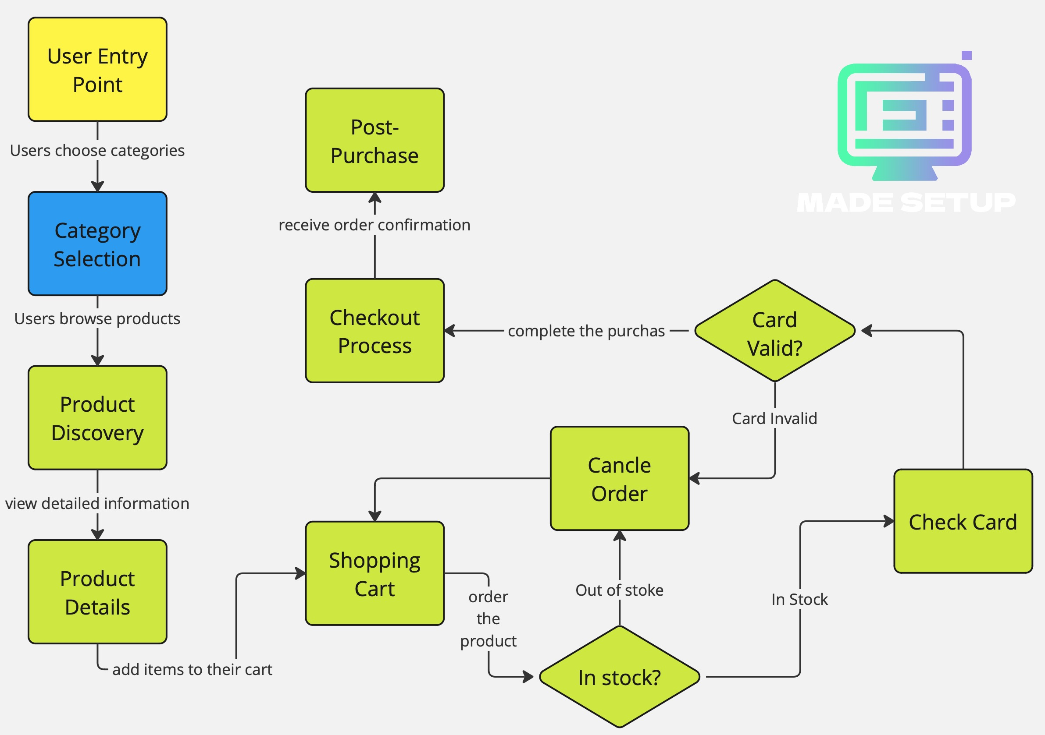
Block Diagram

Slide 4
Experimental setup and Design
Prototyping:
Built prototype with HTML, CSS, JS, and Bootstrap.
Integrated APIs for location and payments.
User Testing:
Tested with gamers, designers, and office users.
Gathered feedback on experience and navigation.
Design Refinement:
Improved UI/UX based on feedback.
Ensured responsiveness across devices.
Performance Metrics:
Tracked KPIs like load time and conversion rates.
Optimized backend for better performance.

Slide 5
List of required Equipments &Software
Hardware:
Workstations: High-performance PCs.
Servers: For website hosting.
Testing Devices: PCs, tablets, smartphones.
Software:
Development: VS Code, Git/GitHub.
Design: Adobe XD/Figma, Photoshop.
Frameworks: Bootstrap, SwiperJS.
Database: MySQL.
APIs: Google Maps, Payment Gateway.

Slide 6
List of required Equipments &Software
3. Testing & Analytics:
Analytics: Google Analytics.
Project Management: JIRA/Trello.

Slide 7
Research Methodology
Literature Review:
Analyzed existing studies on niche e-commerce, user preferences, and market trends.
Market Analysis:
Conducted surveys and focus groups to understand target audience needs (gamers, designers, office users).
Prototype Development:
Created a functional prototype for user testing.

Slide 8
Research Methodology
4. User Testing:
Performed usability tests with target users to gather feedback on design and functionality.
5. Data Analysis:
Analyzed user feedback and behavioral data to refine the platform.
6. Iterative Design:
Made continuous improvements based on testing outcomes and data insights.

Slide 9
Objective of project
Streamline Shopping:
Provide a unified platform for purchasing setup-related products and PC parts.
Enhance User Experience:
Offer tailored recommendations and easy navigation for specific needs (gaming, design, office).
Ensure Quality:
Curate high-quality products to ensure compatibility and reliability.
Simplify Decision-Making:
Help users make informed choices with expert guidance and curated selections.

Slide 10
THANK YOU

